Slide 1
Micro: bit Connections

Slide 2
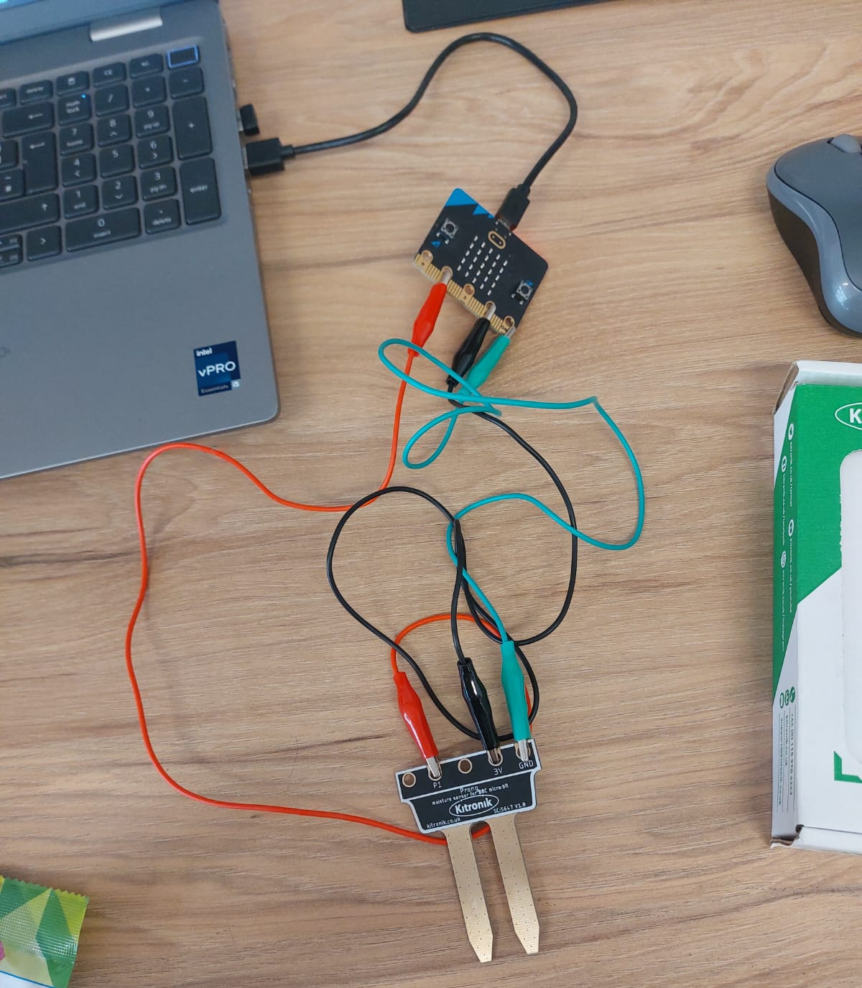
Soil Moisture Prongs

Slide 3
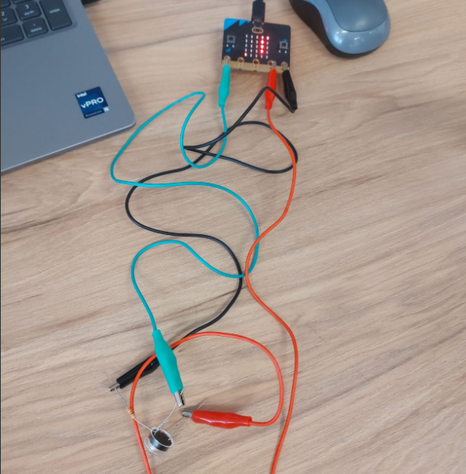
LDR (with resistor)

Slide 4
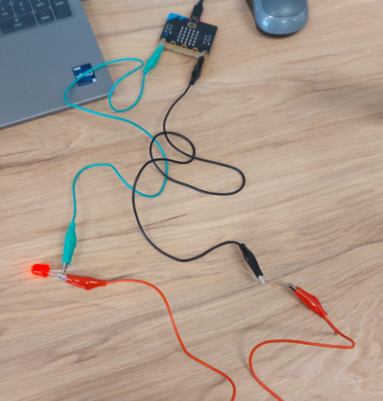
LED (with resistor)

Slide 5
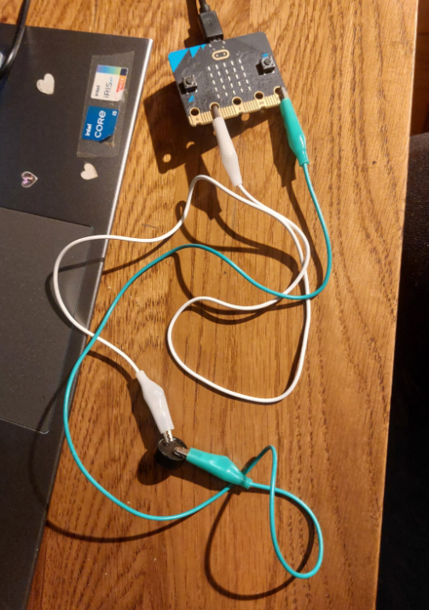
Buzzer

Slide 6
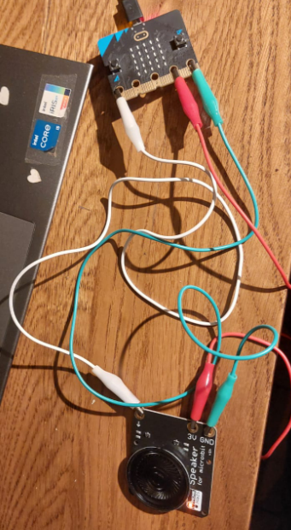
Speaker

Slide 7
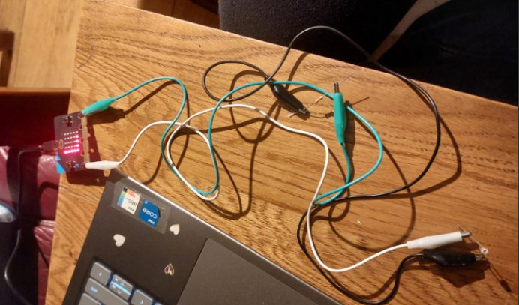
Photodiode (with resistor)

Slide 8
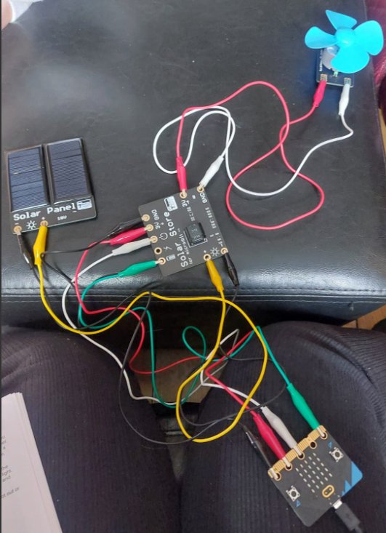
Solar Energy Store & automatic Fan set up

Slide 9
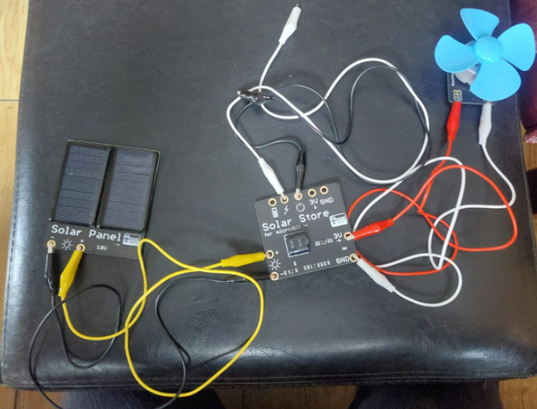
Solar Energy Store & Fan set up

Slide 10
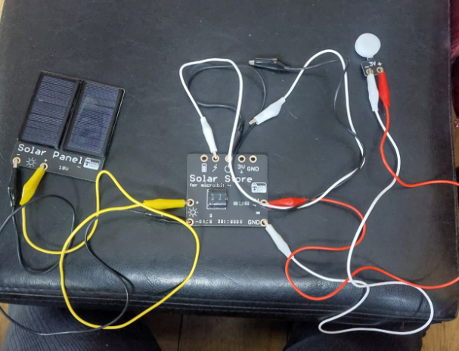
Solar Energy Store & light set up

Slide 11
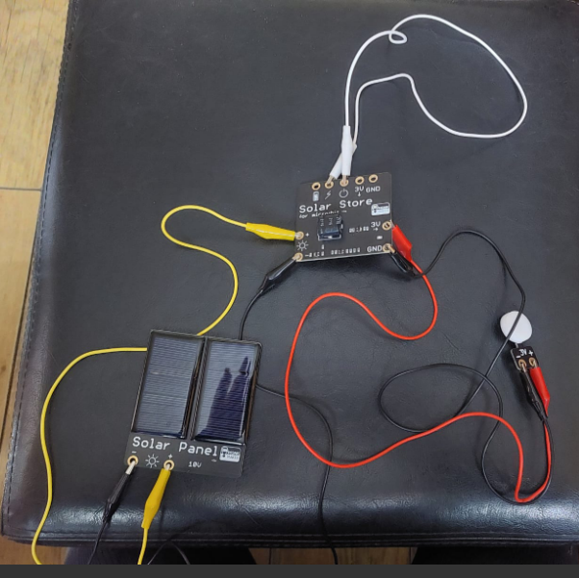
Solar Energy Store & automatic light set up

Slide 12
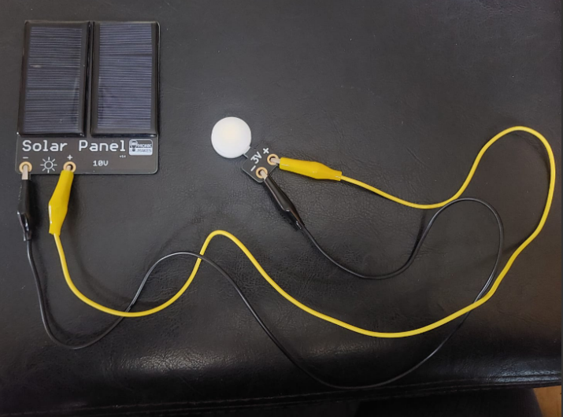
Solar Panel Powered light

Slide 13
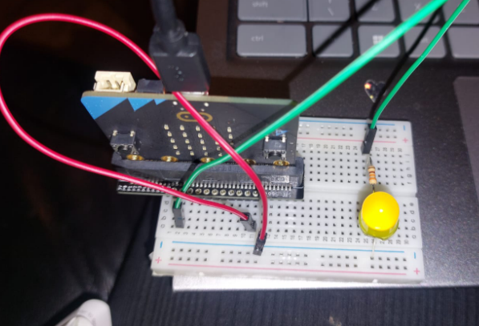
LED & Resistor connection on breadboard

Slide 14
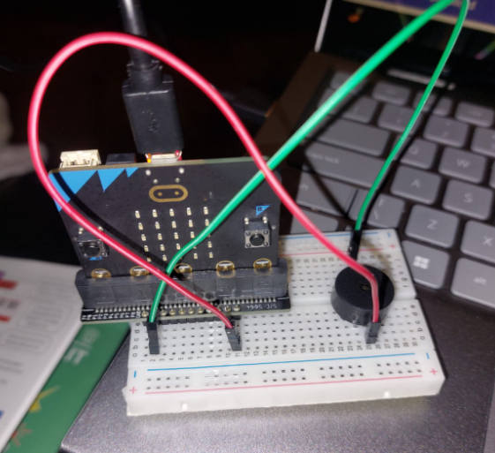
Buzzer connection on breadboard

Slide 15
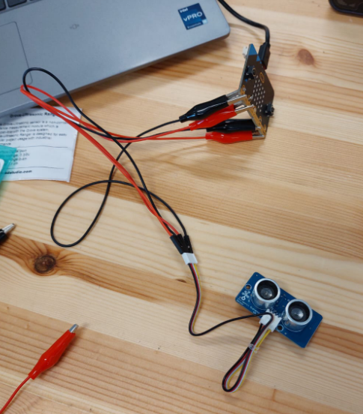
Ultrasonic distance sensor

Slide 16
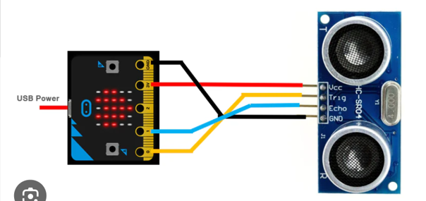

Slide 17
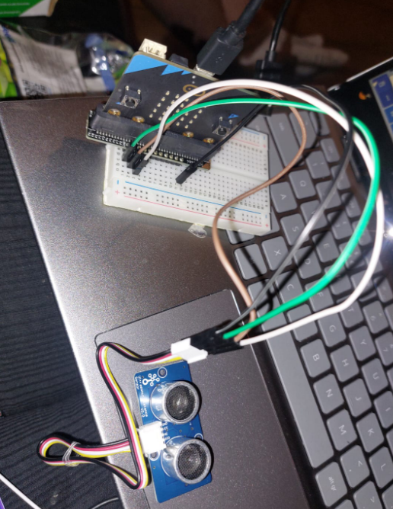
Ultrasonic distance sensor using breadboard

Slide 18
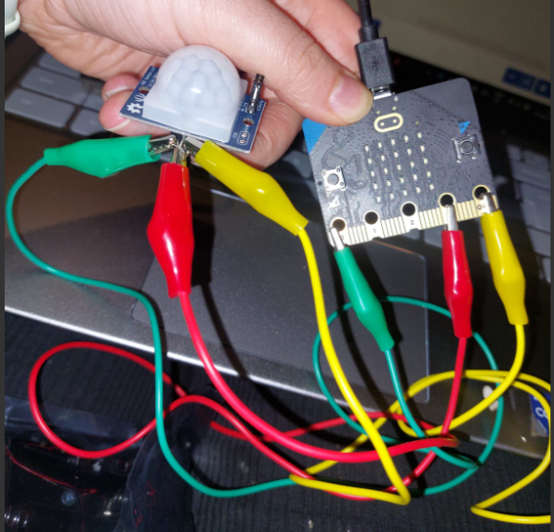
PIR sensor

Slide 19
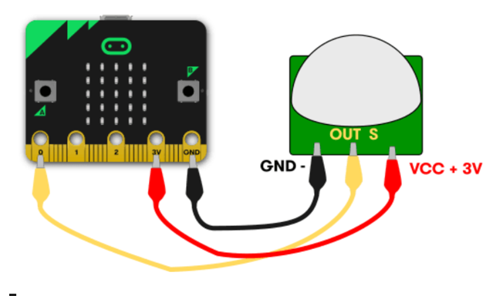

Slide 20
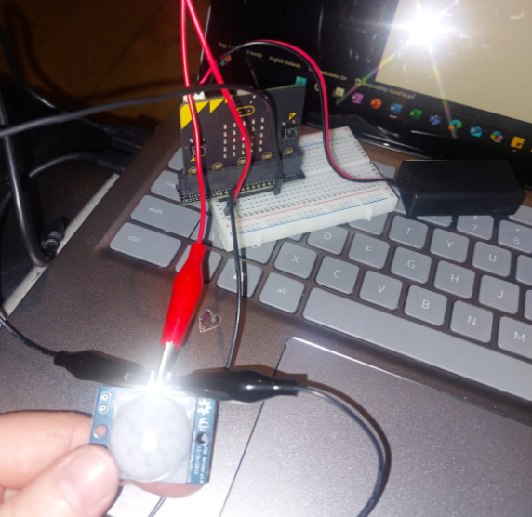
PIR sensor using breadboard

Slide 21
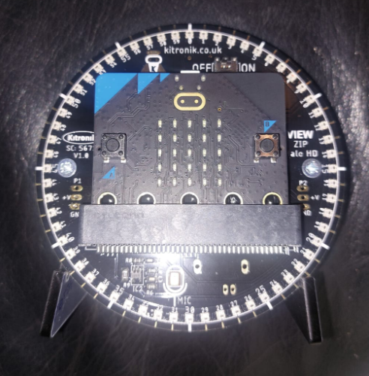
60 LED Halo HD connection

